Slide 1


Slide 2
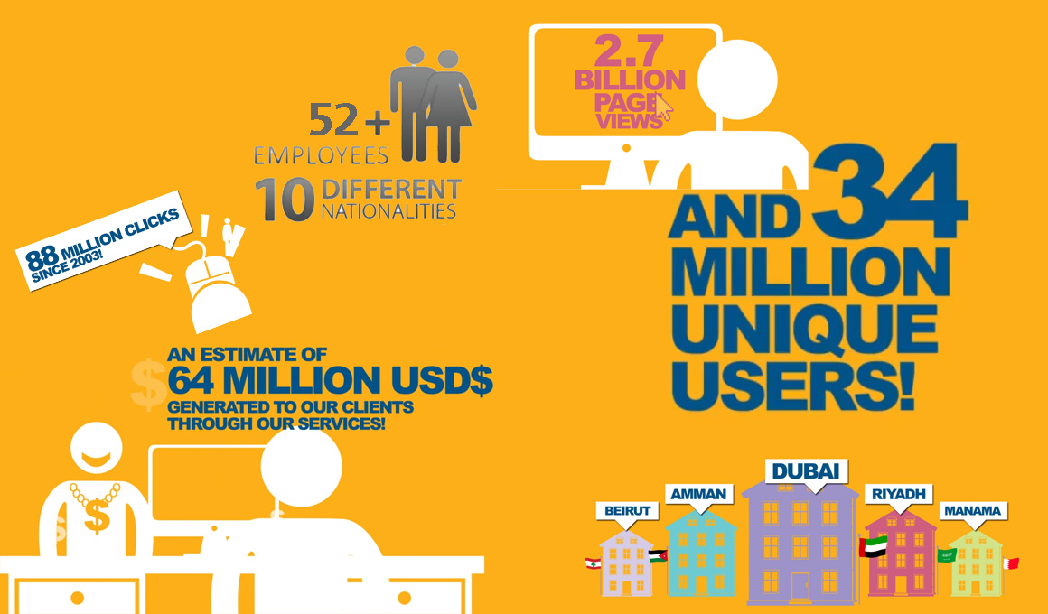
The Company
Net Advantage, is a specialized digital Media House that represents leading digital titles in Arabia, offering advertisers windows of engagement reaching multiple layers of their target audience. It thus serves as an active hub between advertising agencies and a selective list of diversified web portals, primarily in Arabia and thereafter, internationally.
Serving
Agencies
and
Direct Clients
Established
2003
Display Ads
Social Marketing
Content Seeding
Sponsorships

Slide 3


Business Model
Exclusively represents leading thematic portals in different categories. It is either contacted by the advertising agency, or wins a campaign via successful pitching, and sells inventory spaces on its publishers’ websites to the ad agency under the terms of the specific online ad campaign.
NetAd sells ad-placement inventory (banners) on the portals, and according to its representation contract revenue is shared on 40:60 basis (after deducting agency commissions). 40% goes to Net Advantage and 60% to the portal.
Portals
Agencies
Mobile Apps
Facebook
Direct Clients
Twitter
Other Social Media

Slide 4
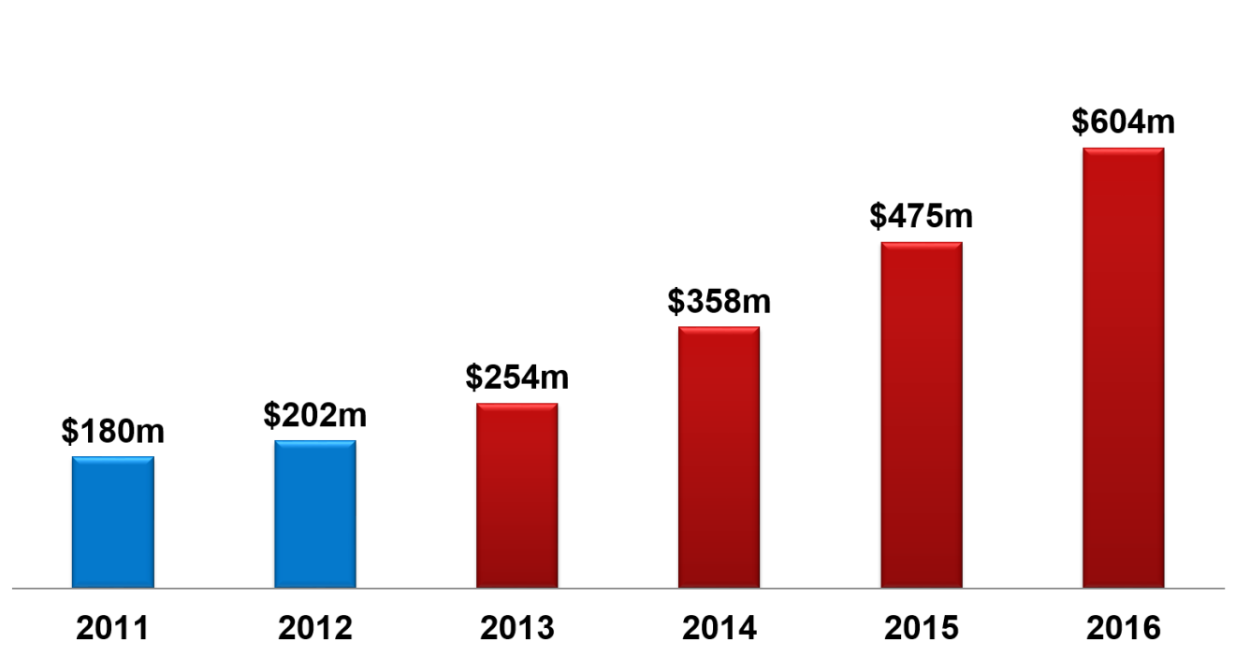
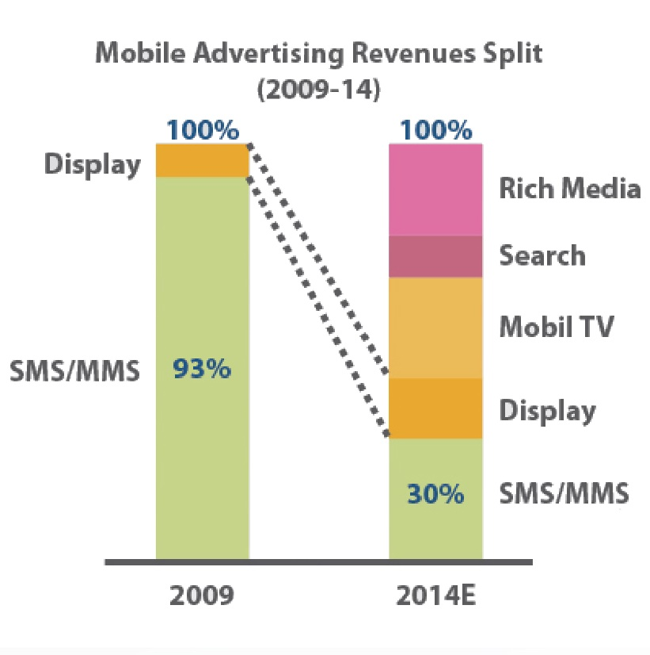
Market Overview
Based on the number of estimates, including the Arab Media Outlook 2009-2013, online advertising is estimated between 2% -4% of the total advertising market in the Arab region which makes it in 2011 in the range of $110 –$220 M.
Digital Advertisement Growth in MENA
Market is Maturing and started demanding advance marketing offering such as :
Retargeting clients on network
Behavior Targeting
CPC and CPA (Clicks and Action)
Content and influencer marketing
Social Marketing and engagement
Non conventional Display Ads
Mobile Ads

Slide 5
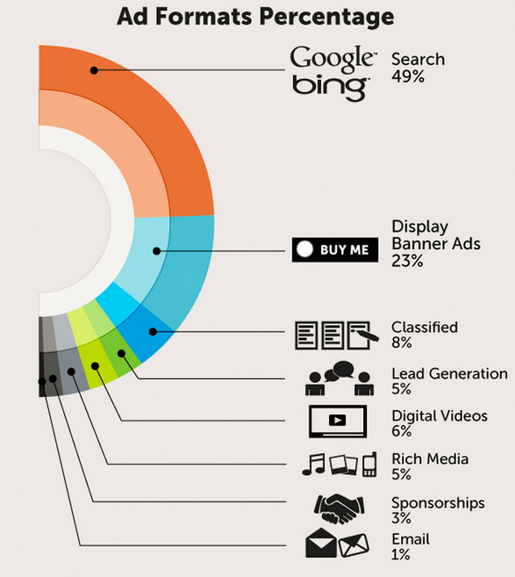
Market Overview
80% of Net advantage Revenue
Today is Display Ads
Expected High Growth in Social and Mobile Ads including Video

Slide 6
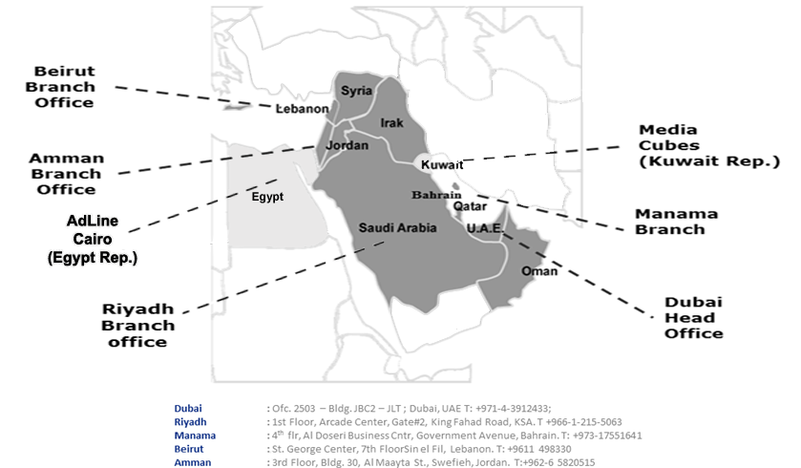
Our Coverage
Net Advantage is have physical offices across UAE ,KSA ,Lebanon ,Bahrain and Jordan

Slide 7


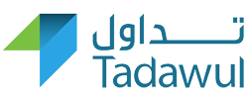








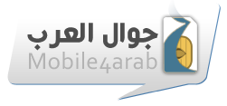









Portfolio
2.7 Billion Page views, 34 Million Unique Users

Slide 8
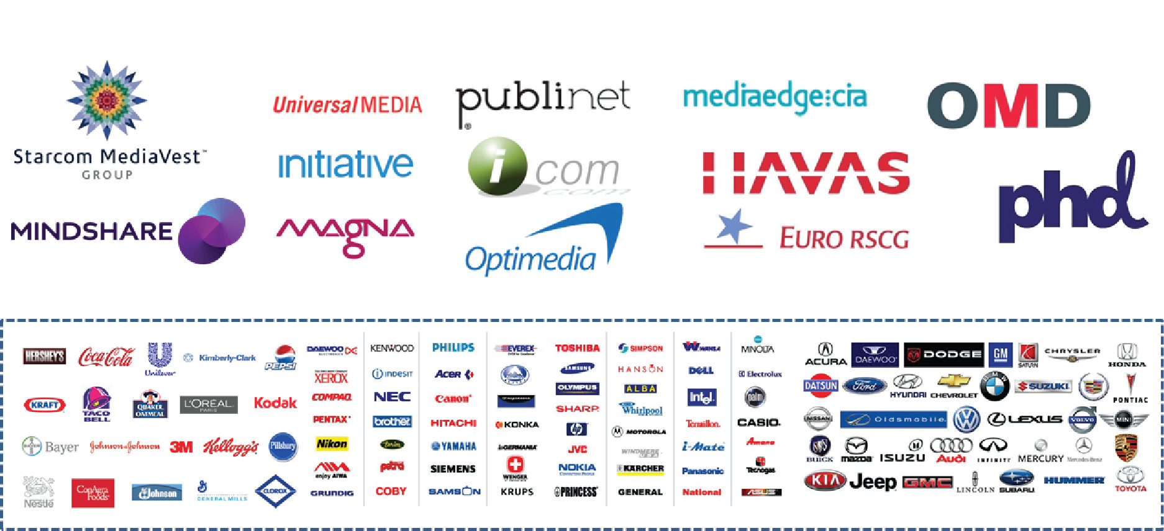
Target Market
Net Advantage works with a number of internationally affiliated advertising and media agencies in the region; which in return represents a wide range of international and regional advertisers in the MENA.

Slide 9



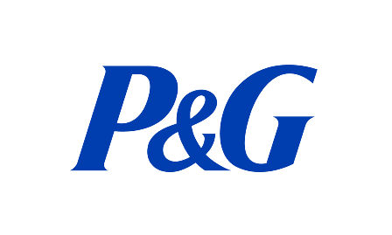
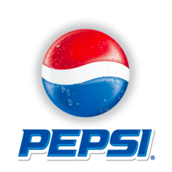

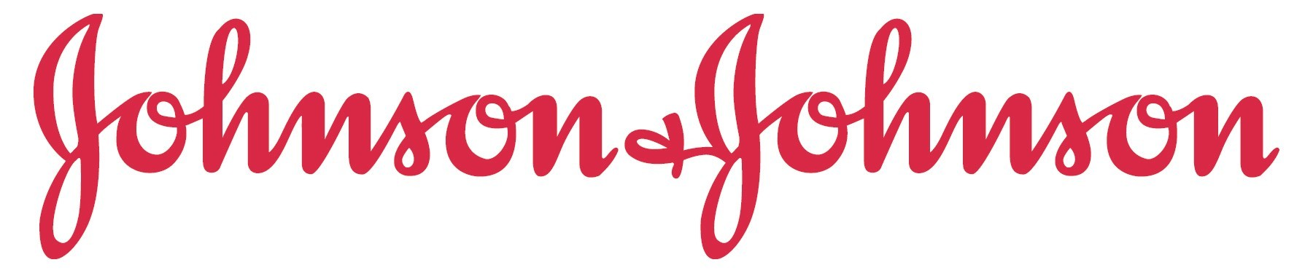




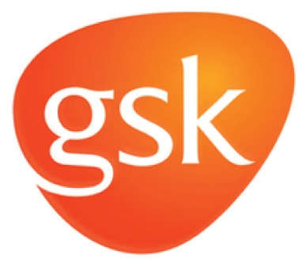
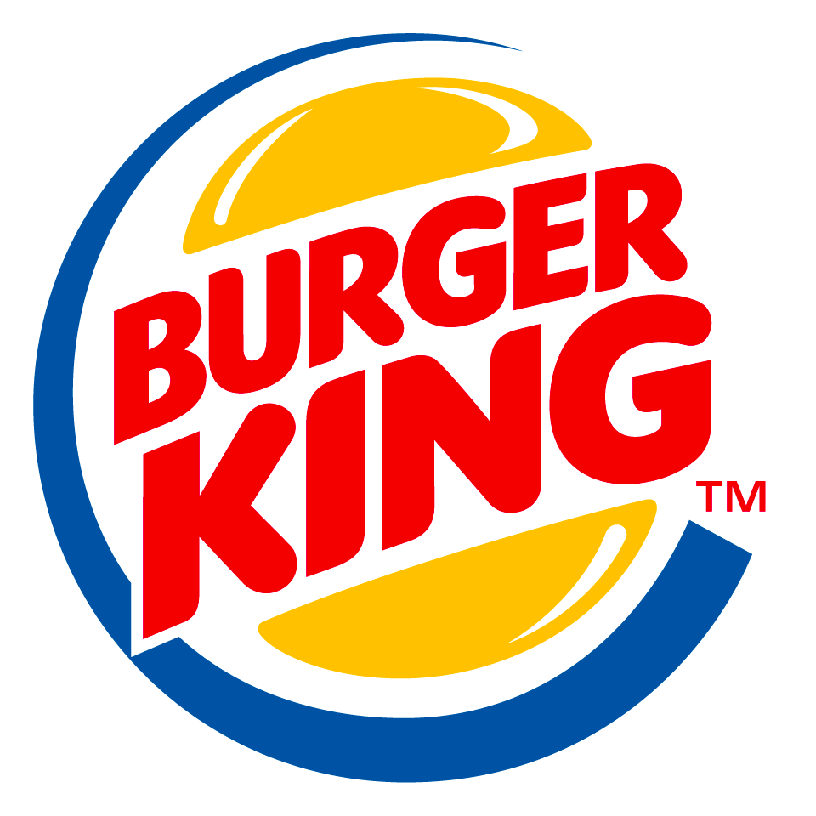








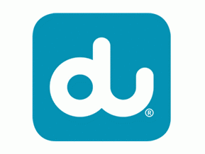
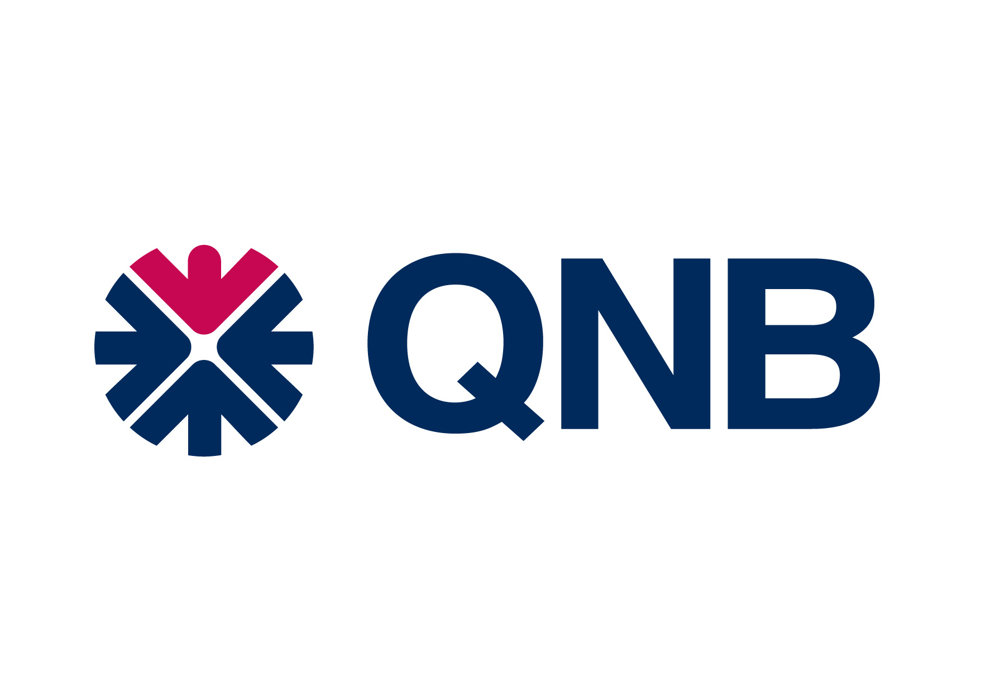


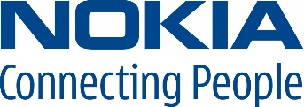

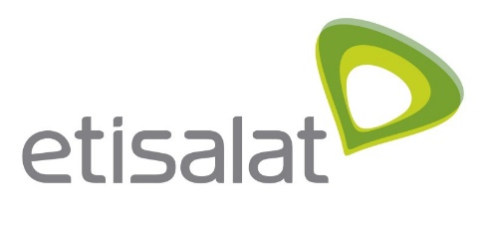
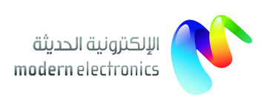

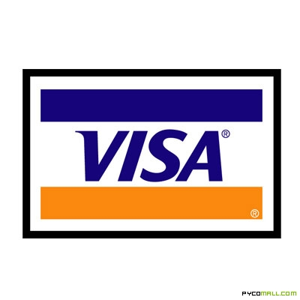


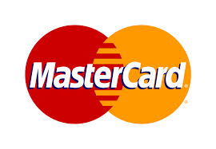
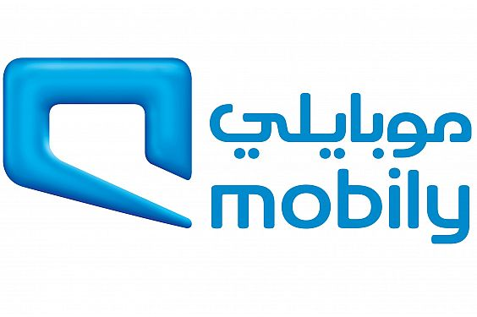


Some Customers

Slide 10
Org. Structure
GM
Sales
(12)
Riyadh
Traffic
(10)
Launch campaigns
Dubai
Bahrain
Levant
Manage ad-servers
Optimization
Resize banners
Client Servicing
(5)
Reporting
Follow-up material
Post campaign Mgmt
Marketing
(2)
Portfolio Marketing
Media Kit
PR
Packaging
Accounting and Admin
(8)
AR
AP
Financial reporting
Social Media
(1)
Forum seeding
Earned Media
Clients FB page mgmt
Reporting
Direct Response
(2)
CPC
CPL
SEM

Slide 11
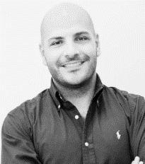
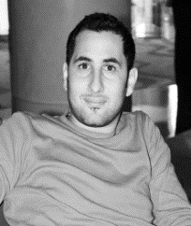

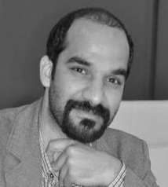
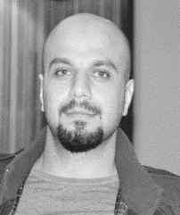
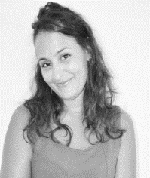
Team
Omar is the GM of NetAdvantage. Omar is a digital marketing specialist having an experience of more than nine years in one of the fastest developing industries in the region. Omar has 360-degrees experience in all aspects of digital advertising life cycle from building the strategy, pitching, buying inventory, launching and reporting online campaign for international/local advertisers.
Georges is the Head of Sales and Operations in Bahrain. With Marketing and Advertising background. Currently the Country Sales Manager of Net Advantage Bahrain since 2010. 2009-2010: Account Executive – Waseet Publication Bahrain Project Manager – Waseet TV Agent for Bahrain Guinness World Record. 2008-2009: Assistant Manager – Christian Dior Boutique Bahrain Sales Advisor – Christian Dior Boutique Abu Dhabi .
Omar Hariz
Georges Zakhour
Zada is the Head of Client Servicing at NetAdvantage. With 9 years of extensive experience across the digital advertising industry within client servicing, sales, media planning, media buying/planning, business development, research, social media, digital media analysis, team management, 3rd party systems, CMS and more.
Bashir is the Head of Sales and Operations in Jordan. A Certified Business Manager who specialized in general management/ operations management/ marketing management/quality and process/ management/ human resources management/ finance/ accounting/ information technology/ corporate control/international business.
Zada Hassi
Bashir Mraish
Nicerin is the Direct Response Manager at NetAdvantage. In her role she handles managing Google search and display campaigns – optimizations, proposals and performance strategy planning Managing performance based campaigns running on premium networks to reach client's KPIs Offering solutions for new and existing campaigns to improve performance based on our portfolio.
Muheeb is the Country Sales Manager in KSA for NetAdvantage. Muheeb has a diverse background, having worked as Electronics Engineer and Project Manager for multiple telco operators in the region. In 2009 he joined NetAdvantage as an Account Executive in KSA. He signed up big customers and exceeded targets, thus becoming country manager in 2011.
Muheeb Tarawneh
Nicerin Sadouki

Slide 12
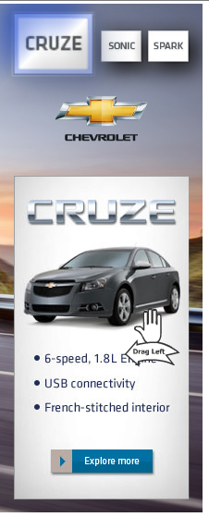
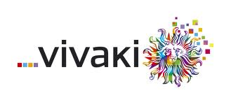


NetAd R&D
Net Advantage empowered the digital marketing industry by MENA by creating and implementing innovative advertising tools and approaches to help conversions for Clients … the list is long but we will mention :
“Net Advantage winning the best creation of interactive banner in 2012”
“Vivaki announced "Tri-ad", initially proposed by Net Advantage, as the winning ad model."After several rounds of intense research, Vivaki announced that the Tri-Ad is an optimal model for an exceptional consumer engaging experience”
“AFF Arab football fantasy Gillette Fusion/Head & Shoulders/Hugo Boss
June 24, 2011
“Net Advantage created the best performing convergence platform for P&G ,
AdIndex® Advertising Effectiveness

Slide 13
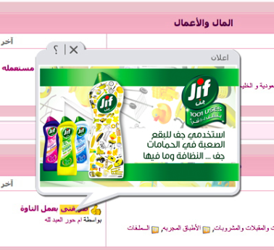
NetAd R&D
Net Advantage empowered the digital marketing industry by MENA by creating and implementing innovative advertising tools and approaches to help conversions for Clients … the list is long but we will mention :
“bubble Ads contextual advertising ”
Bubble Ad is an advertising opportunity for advertisers allowing them to place their ads on a floating Ad that appears above a specific keyword.
Average CTR 1.6

Slide 14
Pricing Models
Agency
Direct client
-15%
Net Advantage
60%
Publisher exclusive
Planning & Management
Agencies retain 15% from clients booking as agency commission
Net Advantage received booking less 15% agency commission
Net advantage book with exclusive publisher and retain 40% ( after agency commission )
Exclusive publisher receive 60 % of booking after the 15% agency commission

Slide 15
Pricing Models
Net Advantage reward the agencies with a rebate for the overall yearly volume booked
Agencies contractually commit with Net Advantage on annual spending
Net Advantage Agencies
The average rebate or volume rebate varies between 13%-16% as an overall

Slide 16

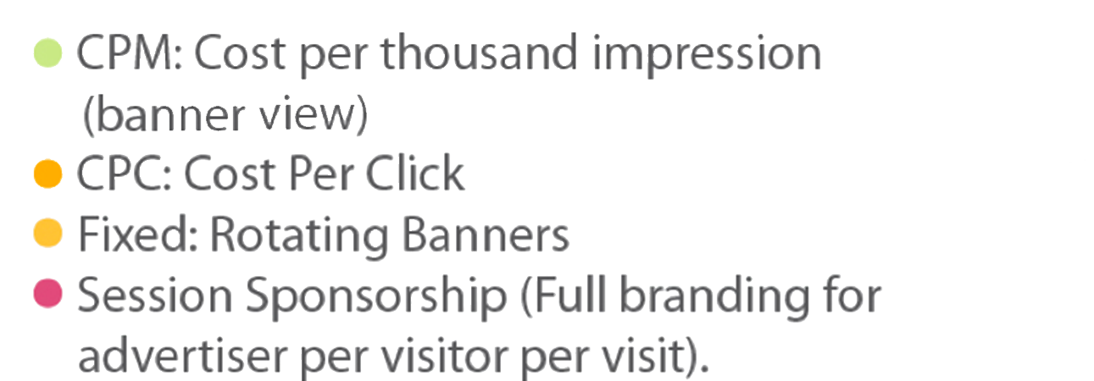
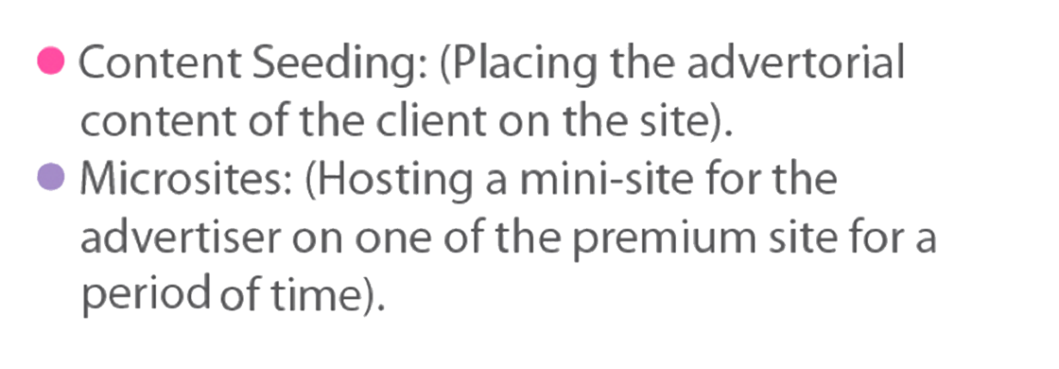
Strategy
We represent niche in each audience profile. Our leading verticals fall into the following categories:
Luxury &
Ecommerce
Finance
Sport
Female
Telcos
Health

Slide 17

Required funding
Increase our Sales team and Geo Coverage
By increasing the number of Sales team Net Advantage can generate more revenue by tapping into direct client ( no agency representation ) expected revenue from direct clients is between $5M - $7M from KSA alone .

Slide 18

Required funding
Hire Business Development and acquire more sites
Business development resources to seek opportunities to further monetize the robust inventory under Net advantage portfolio and to work on other special projects .

Slide 19

Required funding
Grow Net Advantage Network …
Growing the Network vertically net advantage can offer a specialized exposure for clients ( financial network ,luxury network ,pharmaceutical , automotive etc..)
Growing the Network geographically buy creating local network ( Kuwait or Qatar local network form top visited local sites per region )

Slide 20
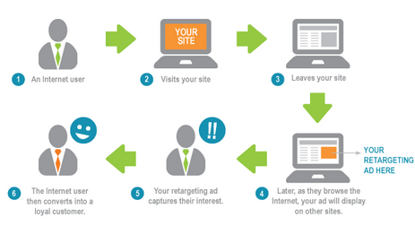
Required funding
Invest in Technology & understand DATA …

Slide 21
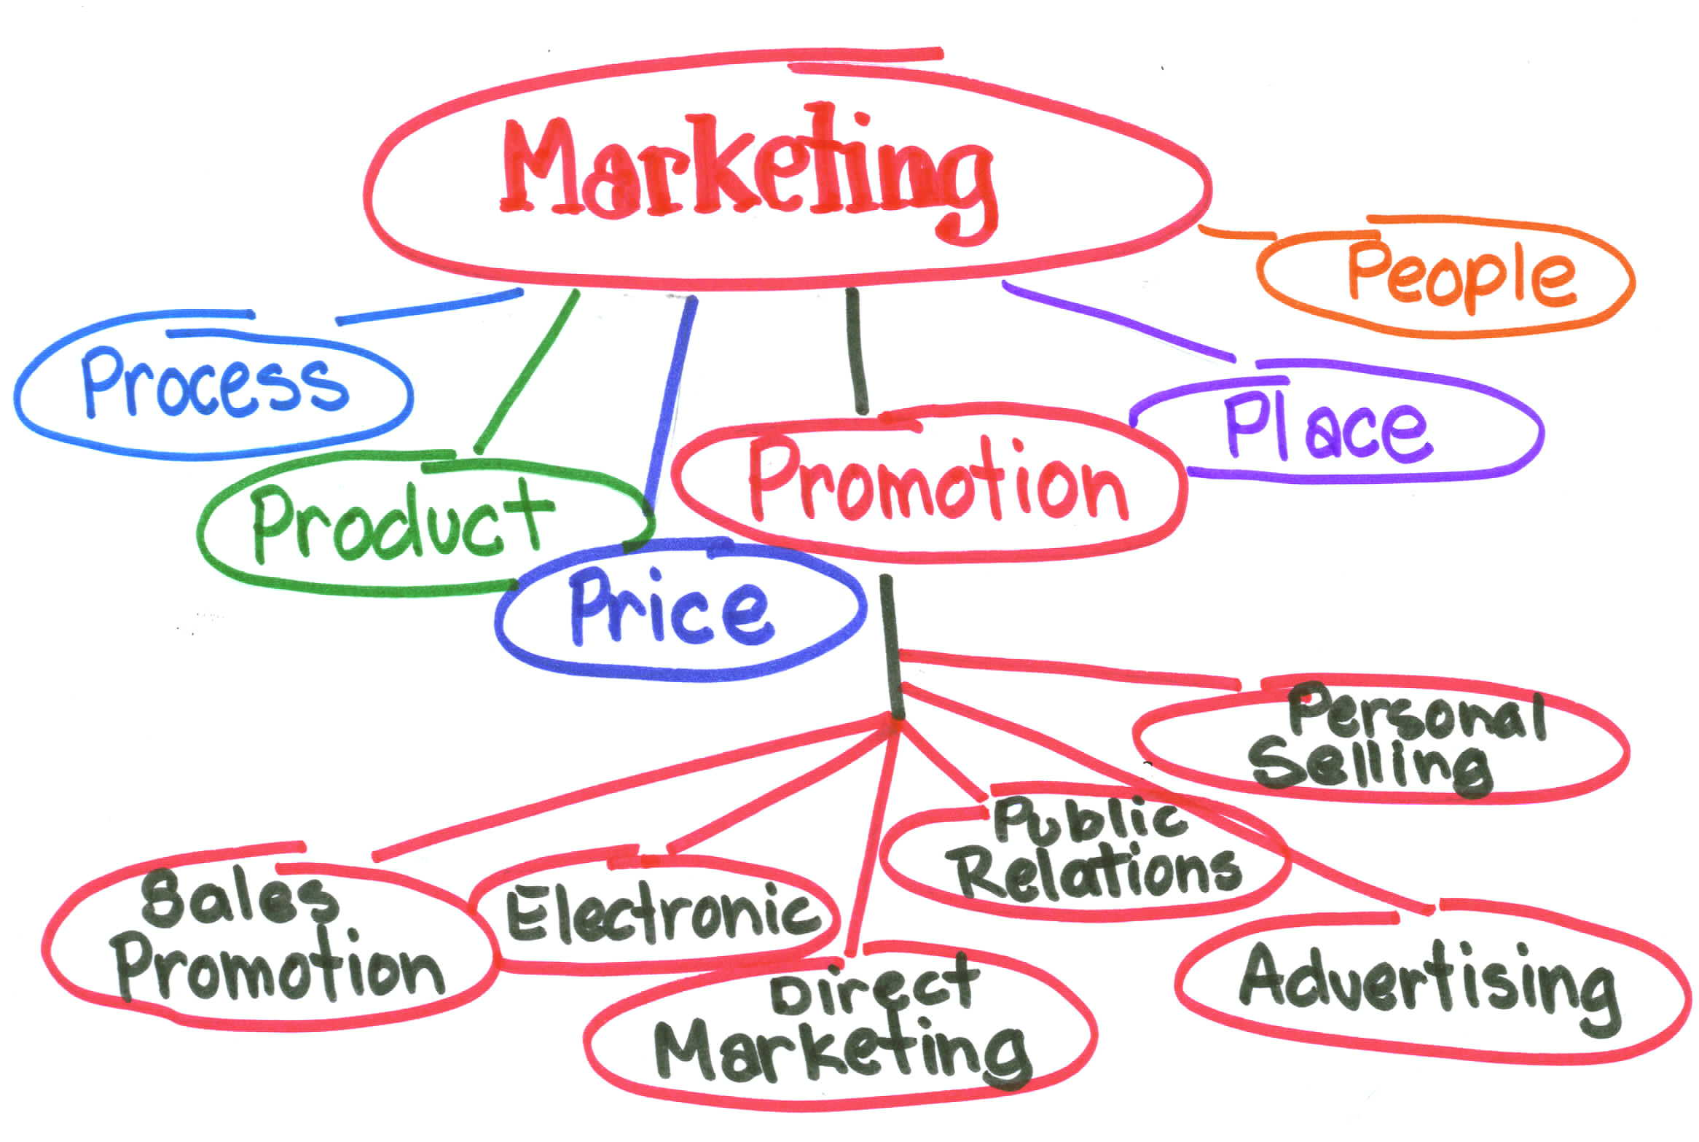
Required funding
Marketing …
To market new initiatives and to assist the BD in promoting new projects.
Setting Price , Promotion, Place etc..
To generate leads for sales

Slide 22
Thank You

